Slide 1
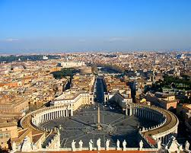
Italy Trip
By Robert Bland, Elijah Slater, and Andr’e Byle

