Slide 1
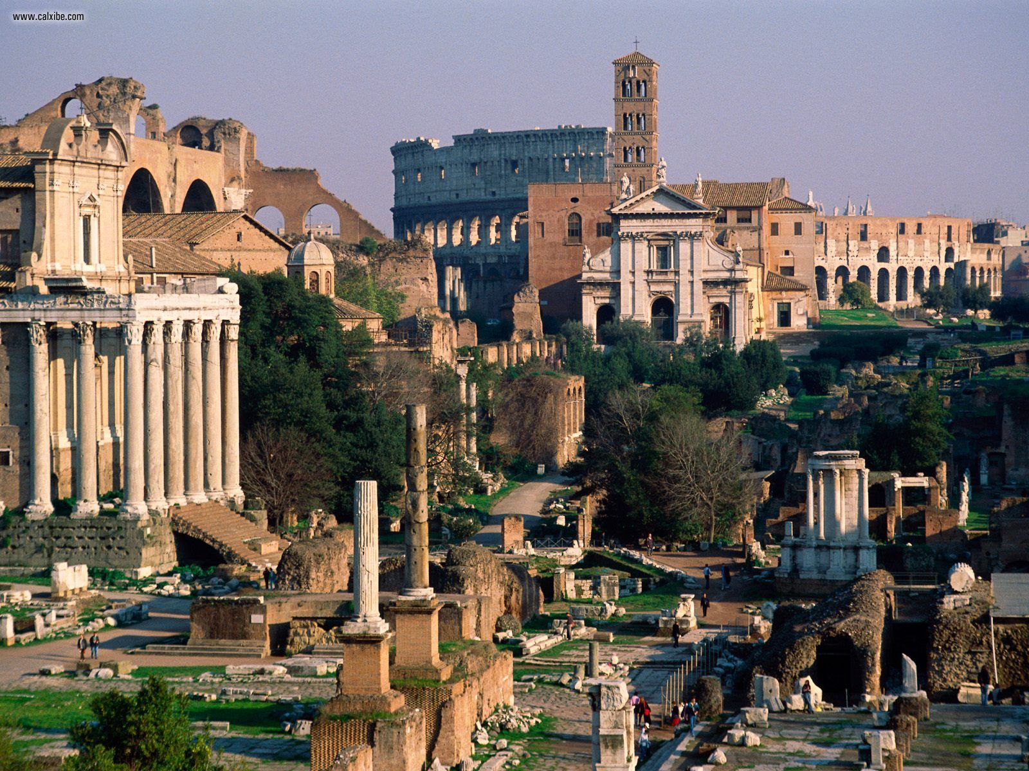
Robert Bland, Elijah Slater, and Andre’ Byl’s Trip to Rome, Italy!

Slide 2
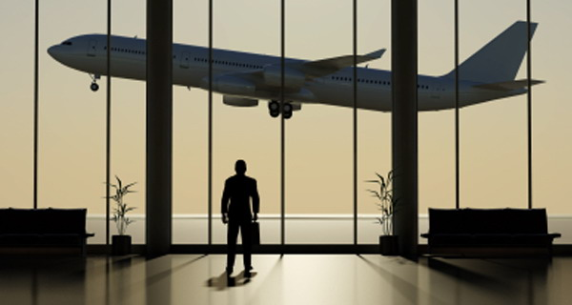
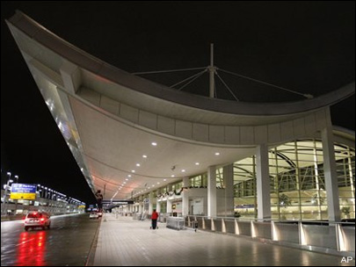
Friday, the 17th of August.
Leaving Detroit, Michigan for Rome, Italy!

Slide 3
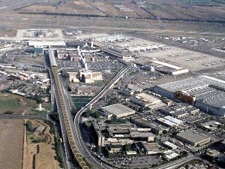
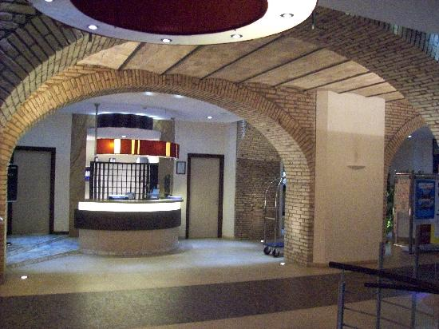
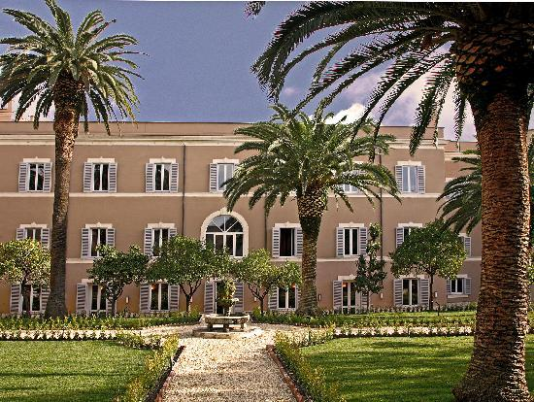
Arriving at Rome international airport!
Checking into the Kolbe Hotel!

